Slide 1
The curious case of plant responses to carbon dioxide
March 9, 2021

Slide 2
Why should we care about plant responses to CO₂?

Slide 4
What causes the variations in the red line?

Slide 5
IPCC (2013)

Slide 6
What do you expect the plant response to be?

Slide 7
Short-term plant response to elevated CO₂: the A-Ci curve

Slide 8
Short-term plant responses to CO2: the A-Ci curve
Long et al. (2003)

Slide 9
Short-term plant responses to CO2: the A-Ci curve
CO₂
Rubisco binds CO2 to RuBP
3-C sugars created
3-C sugars prepared for export
RuBP is regenerated
Glucose et al.
Long et al. (2003)

Slide 10
Short-term plant responses to CO2: the A-Ci curve
CO₂
Rubisco binds CO2 to RuBP
3-C sugars created
3-C sugars prepared for export
RuBP is regenerated
Glucose et al.
Long et al. (2003)

Slide 11
Short-term plant responses to CO2: the A-Ci curve
CO₂
Rubisco binds CO2 to RuBP
3-C sugars created
3-C sugars prepared for export
RuBP is regenerated
Glucose et al.
Long et al. (2003)

Slide 12
Short-term plant responses to CO2: the A-Ci curve
CO₂
Hold on: What is strange about the RuBP regeneration response to CO₂?
Rubisco binds CO2 to RuBP
3-C sugars created
3-C sugars prepared for export
RuBP is regenerated
Glucose et al.
Long et al. (2003)

Slide 13
Short-term plant responses to CO2: the A-Ci curve
CO₂
Rubisco binds CO2 to RuBP
3-C sugars created
3-C sugars prepared for export
RuBP is regenerated
Glucose et al.
Long et al. (2003)

Slide 14
This response is relatively consistent across species and fairly easy to measure!

Slide 15
What do you expect the plant response to be?

Slide 16
How might the long-term response to elevated CO₂ differ?

Slide 17
How might the long-term response to elevated CO₂ differ?
Things to consider:
Each component represents a within leaf investment
Plants generally aim for efficiency
RuBP regeneration is principally determined by light availability
Rubisco is an expensive enzyme (lots of N)

Slide 18
Ainsworth and Long (2005)

Slide 19
What does this mean for the whole plant?

Slide 21
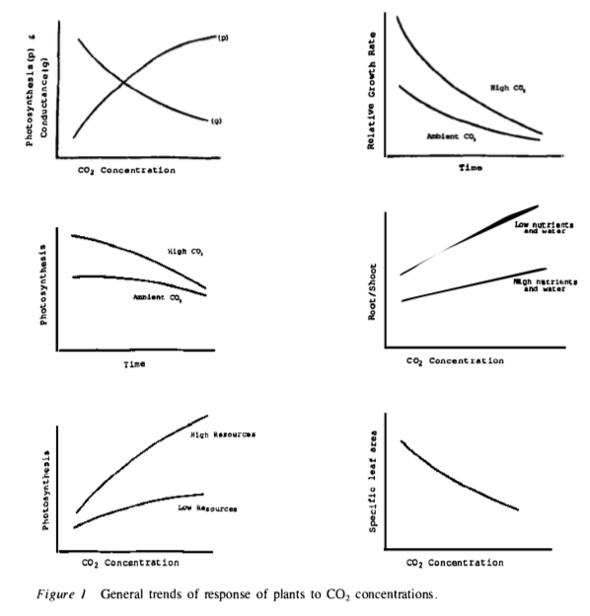
Bazzaz (1990)

Slide 22
What does this mean for the whole ecosystem?

Slide 24
What do you expect the plant response to be?
Draw a systems diagram

